Slide 1


Slide 2
Goals
Introduction to Data
Introduction to MySQL
RDBMS
Datatypes
Databases
Tables
SQL Queries
Join
Indexes and Stored Procedures

Slide 3
Goals
Normalization
MySQL in Cloud
MySQL Heatwave in ML

Slide 4
Introduction to Data
Data is a collection of information gathered by observations, measurements, research or analysis.
They may consist of facts, numbers, names, figures or even description of things.
Data is organized in the form of graphs, charts or tables.
There exist data scientist who does data mining and with the help of that data analyze our world.

Slide 5
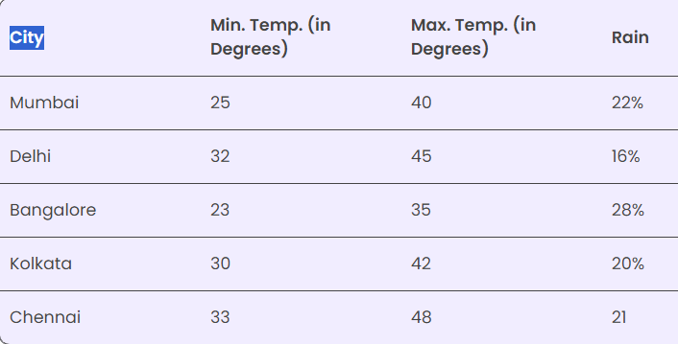
Introduction to Data

Slide 6
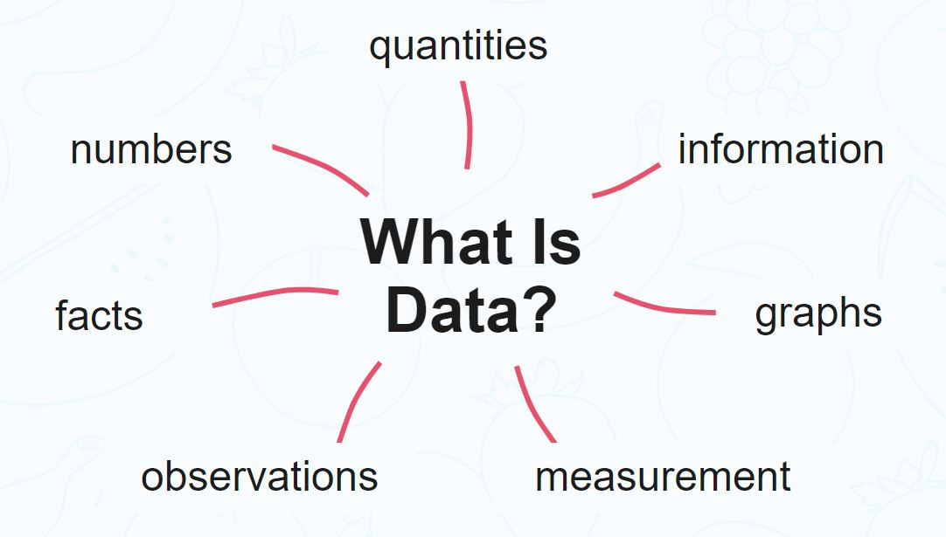
Introduction to Data
Data are units of information.
Data can be collected on any topic and for any purpose, meaning that it is used in everything from scientific research and finance to business management and retail.

Slide 7
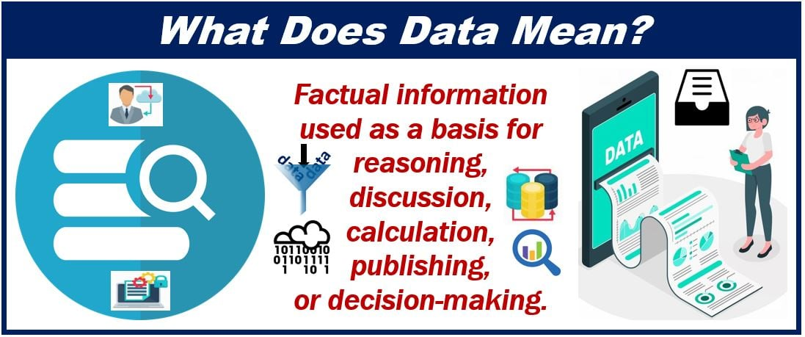
Introduction to Data

Slide 8
Data Acquisition
A data acquisition system is a system that comprises sensors, measurement devices, and a computer.
A data acquisition system is used for processing acquired data, which involves collecting the information required to understand electrical or physical phenomena.

Slide 9

Data Acquisition

Slide 10
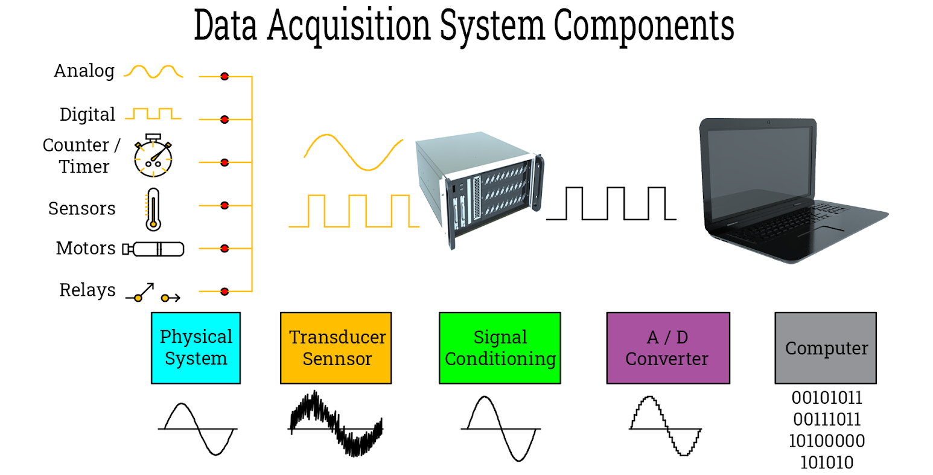
Basic Components of Data Acquisition System

Slide 11
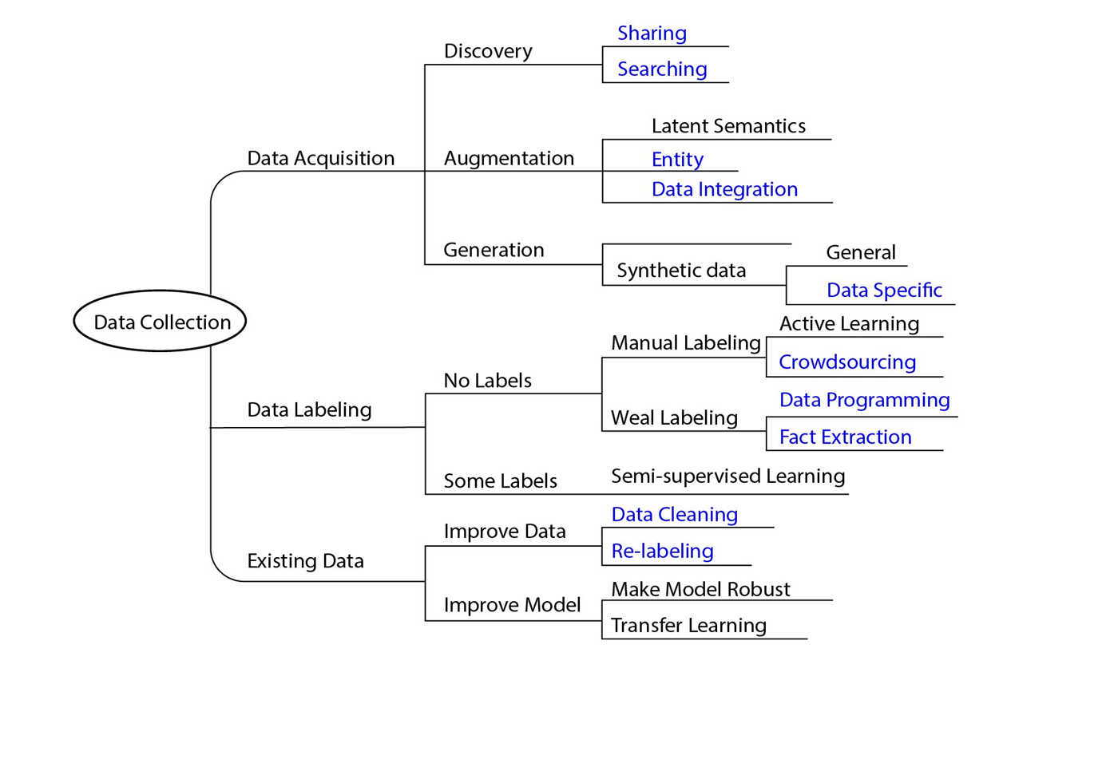
Basic Components of Data Acquisition System

Slide 12
Data Ingestion
Data ingestion is the transportation of data from assorted sources to a storage medium where it can be accessed, used, and analyzed by an organization.
The destination is typically a data warehouse, data mart, database, or a document store.
Sources may be almost anything — including SaaS data, in-house apps, databases, spreadsheets, or even information scraped from the internet.

Slide 13
Data Ingestion
In a broader sense, data ingestion can be understood as a directed dataflow between two or more systems that result in a smooth, and independent, operation (a definition which already implies some independence or automation).
Ingestion can occur in real-time, as soon as the source produces it, or in batches, when data is input in specific chunks at set periods.
Generally, three steps occur within data ingestion:
Data extraction – retrieving data from sources
Data transformation – validating, cleaning, and normalizing data to ensure accuracy and reliability (sometimes known as trustworthiness)
Data loading – routing or placing the data in its correct silo or database for analysis

Slide 14
Reasons to automate data ingestion
Automating data ingestion improves time-to-market goals.
Automating data ingestion increases scalability.
Automating data ingestion refocuses on necessary work.
Automating data ingestion mitigates risk.

Slide 15
Data Ingestion Tools
Apache NiFi (a.k.a. Hortonworks DataFlow)
Stream Sets Data Collector (SDC)
Gobblin
Sqoop
Flume
Kafka
Airflow
Spark
petl

Slide 16
Data Ingestion Tools
Panoply
Pandas
Bubbles
Bonobo
Luigi
etlalchemy

Slide 17


Slide 18
Data Types
Quantitative Data Type: –
This type of data type consists of numerical values. Anything which is measured by numbers.
ex., Profit, Quantity Sold, Height, Weight, Temperature, etc.

Slide 19
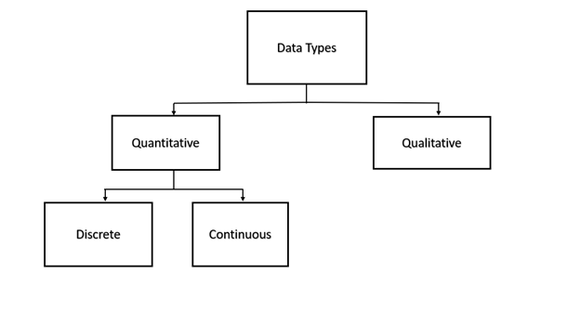
Data Types

Slide 20

Data Types
A.) Discrete Data Type: –
The numeric data which have discrete values or whole numbers.
This type of variable value if expressed in decimal format will have no proper meaning.
Their values can be counted.
ex: – No. Of Cars You Have, No. Of Marbles In Containers, Students In A Class, etc.

Slide 21
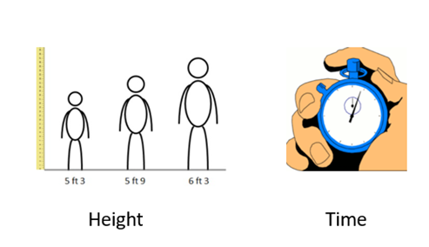
Data Types
B.) Continuous Data Type: –
The numerical measures which can take the value within A certain range.
This type of variable value if expressed in decimal format has true meaning.
Their values can not be counted but measured. The value can be infinite
ex: – Height, Weight, Time, Area, Distance, Measurement Of Rainfall, etc.

Slide 22
Data Types
Qualitative Data Type: –
These are the data types that cannot be expressed in numbers.
This describes categories or groups and is hence known as the categorical data type.

Slide 23
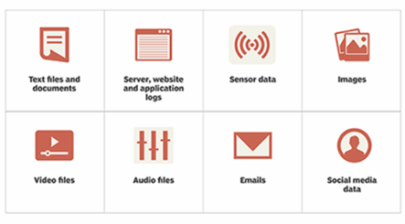
Data Types
Unstructured Data:
This type of data does not have the proper format and therefore known as unstructured data.
This comprises textual data, sounds, images, videos, etc.

Slide 24
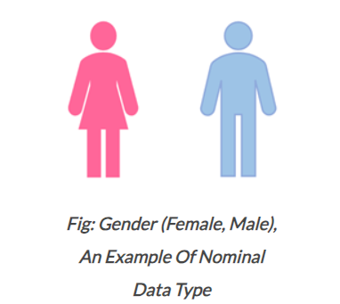
Data Types
Nominal Data Type:
This is in use to express names or labels which are not order or measurable.
ex., Male or female (gender), race, country, etc.

Slide 25
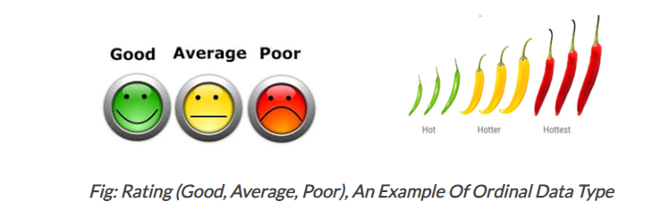
Data Types
Ordinal Data Type:
This is also A categorical data type like nominal data but has some natural ordering associated with it.
Ex., Likert rating scale, shirt sizes, ranks, grades, etc.,

Slide 26
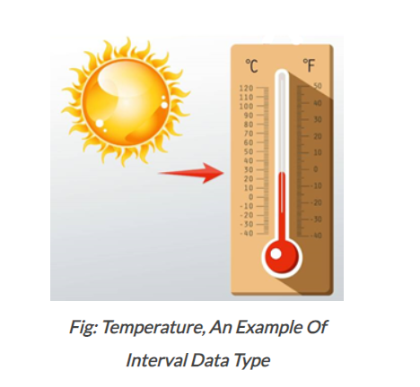
Data Types
Interval Data Type:
This is numeric data which has proper order and the exact zero means the true absence of A value attached.
Here zero means not A complete absence but has some value. This is the local scale.
ex., Temperature measured in degree Celsius, time, sat score, credit score, PH, etc. Difference between values is familiar. In this case, there is no absolute zero. Absolute

Slide 27
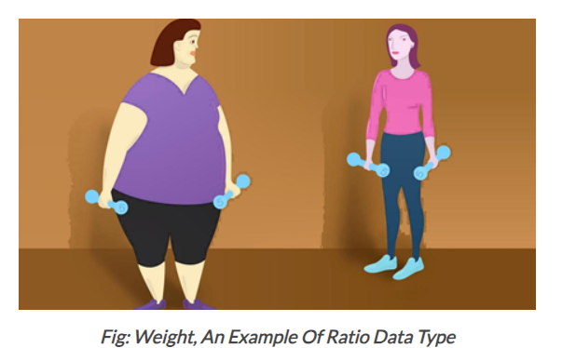
Data Types
Ratio Data Type:
This quantitative data type is the same as the interval data type but has the absolute zero. Here zero means complete absence and the scale starts from zero. This is the global scale.
ex., Temperature in kelvin, height, weight, etc.

Slide 28
Data Storage
Data storage, or data keeping, is storing information and making it as readily available as possible via technology designed particularly for that purpose.
It constitutes a simple method of storing data in digital form on computer devices, and keeping data on hand makes many digital processes more effective.
Storage devices may use electromagnetic, optical, or other media to keep the data safe and recover it when necessary.
File recovery and backup procedures become simple by data storage in the case of an unforeseen computer failure or cyberattack.

Slide 29

Data Storage

Slide 30
NAS (Network-Attached Storage)
A network-attached storage (NAS) server is a specific storage platform that links to devices over a LAN.
The server’s connectivity features allow for the retrieval and storage of data from many external devices, and NAS storage also offers extensive sharing capabilities.
The system utilizes the features of a file-storage technology and the clustering of a redundant array of drives (RAID).

Slide 31
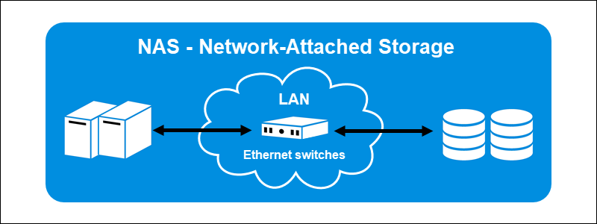
NAS (Network-Attached Storage)

Slide 32
SAN (Storage Area Network)
A storage area network (SAN) is a network-based storage that can access data at the block level.
This kind of storage consists of several data storage units connected by a network.
The storage format is an amalgam of NAS and DAS.
The storage type transfers data across a server and storage using specific networking protocols, like Fiber Channels.

Slide 33
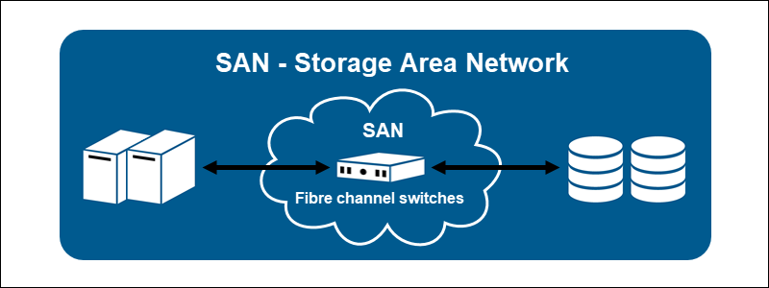
SAN (Storage Area Network)

Slide 34
Data from Various Sources
CSV file
Flat File (tab, space, or any other separator)
Text File (In a single file — reading data all at once)
ZIP file
Multiple Text Files (Data is split over multiple text files)
Download File from Internet (File hosted on a server)
Webpage (scraping)
APIs (JSON)
Text File (Reading data line by line)
RDBMS (SQL Tables)

Slide 35
B-Tree Data Structure
A B-tree is a sort of self-balancing search tree whereby each node could have more than two children and hold multiple keys.
It’s a broader version of the binary search tree. It is also usually called a height-balanced m-way tree.

Slide 36
B-Tree Data Structure
B Tree is a specialized m-way tree that can be widely used for disk access.
A B-Tree of order m can have at most m-1 keys and m children.
One of the main reason of using B tree is its capability to store large number of keys in a single node and large key values by keeping the height of the tree relatively small.

Slide 37
Need for B-Tree
The need for B-tree emerged as the demand for faster access to physical storage media such as a hard disk grew.
With a bigger capacity, backup storage devices were slower.
There was a demand for data structures that reduced the number of disc accesses.

Slide 38
Need for B-Tree
A binary search tree, an AVL tree, a red-black tree, and other data structures can only store one key in each node.
When you need to store a significant number of keys, the height of such trees grows quite vast, and the time it takes to access them grows.

Slide 39
Need for B-Tree
B-tree, on the other hand, can store multiple keys inside a single node and has several child nodes.
It considerably reduces the height, allowing for speedier disk access.

Slide 40
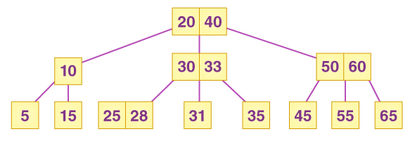
B-Tree Data Structure

Slide 41
Properties of B Tree in DBMS
A B tree of order m contains all the properties of an M way tree. In addition, it contains the following properties.
Every node in a B-Tree contains at most m children.
Every node in a B-Tree except the root node and the leaf node contain at least m/2 children.
The root nodes must have at least 2 nodes.
All leaf nodes must be at the same level.
It is not necessary that, all the nodes contain the same number of children but, each node must have m/2 number of nodes.

Slide 42
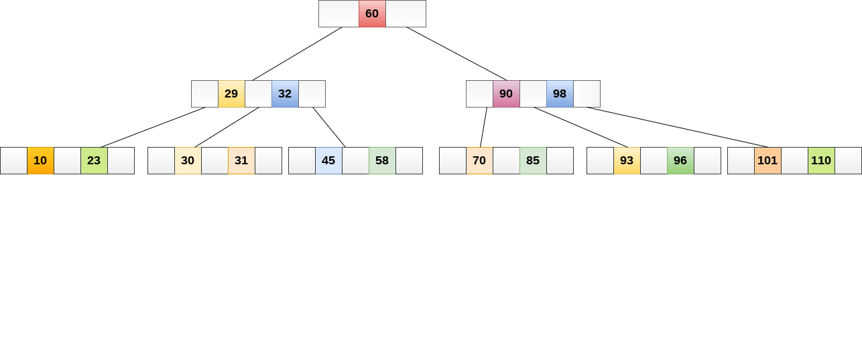
B-Tree Data Structure
A B tree of order 4 is shown in the following image.

Slide 43
Operations
Search Operation
B Trees are comparable to Binary Search Trees in terms of searching. For example, let’s look for item 49 in the B Tree below.
The procedure will go somewhat like this:
Compare item 49 to node 78, which is the root node. Move to the left sub-tree since 49 < 78.
Since 40 < 49 < 56, move to the right subtree of 40. If 49>45, move to the right, and then compare and contrast 49.
Return if a match is found.
The height of the tree affects the search in a B tree. To search an element in a B tree, the search technique requires O(log n) time.

Slide 44
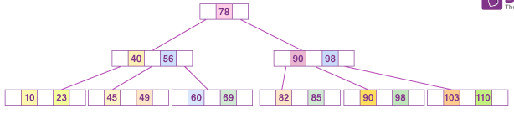
Operations

Slide 45
Operations
Insertion Operation
At the leaf node level, insertions are made. To place an item into B Tree, the following algorithm must be followed:
Navigate the B Tree until you find the suitable leaf node to insert the node at.
If there are fewer than m-1 keys in the leaf node, insert the elements in ascending order.
Otherwise, if the leaf node comprises m-1 keys, proceed to the next step.
In the rising sequence of elements, add the new element.
In the middle, divide the node into two nodes.
The median element should be pushed up to its parent node.
If the parent node has the same m-1 number of keys as the child node, split it as well using the very same steps.

Slide 46
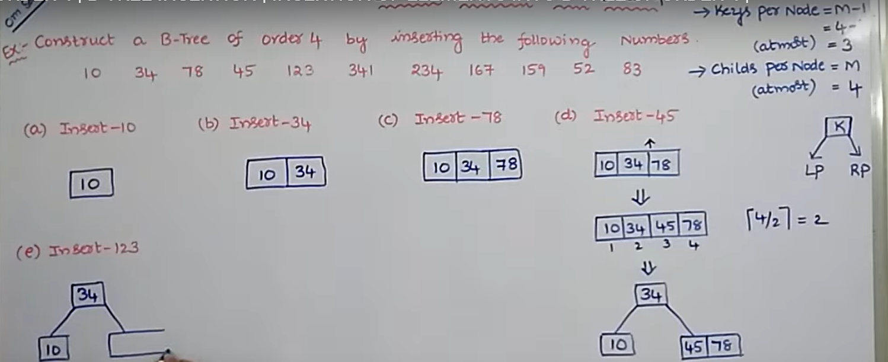
Operations

Slide 47
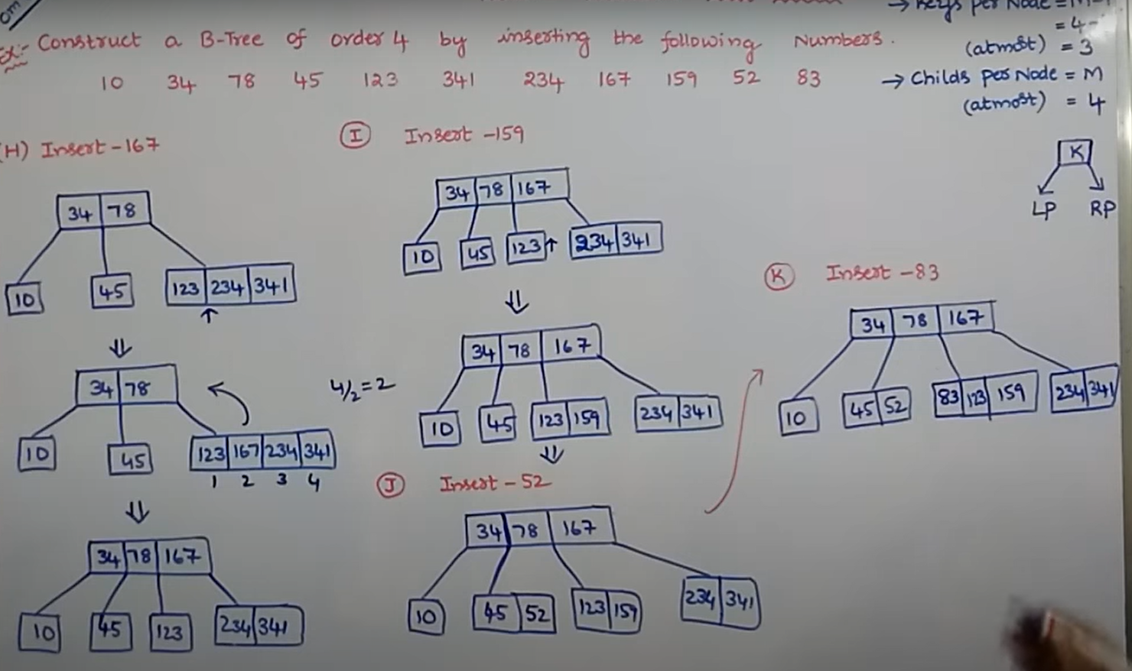
Operations

Slide 48
Difference between Structured, Semi-structured and Unstructured data
PROPERTIES | STRUCTURED DATA | SEMI-STRUCTURED DATA | UNSTRUCTURED DATA
Technology | It is based on Relational database table | It is based on XML/RDF | It is based on character and binary data
Transaction management | Matured transaction and various concurrency technique | Transaction is adapted from DBMS not matured | No transaction management and no concurrency
Version management | Versioning over tuples,row,tables | Versioning over tuples or graph is possible | Versioned as whole
Flexibility | It is sehema dependent and less flexible | It is more flexible than structuded data but less than flexible than unstructured data | it very flexible and there is abbsence of schema
Scalability | It is very difficult to scale DB schema | It’s scaling is simpler than sstructured data | It is very scalable
Robustness | Very robust | New technology, not very spread | —
Query performance | Structured query allow complex joining | Queries over anonymous nodes are possible | Only textual query are possible

Slide 49
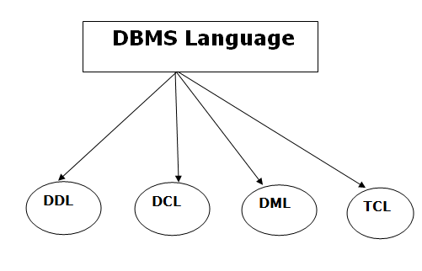
Database Languages

Slide 50
Database Languages
Data Definition Language (DDL)
DDL stands for Data Definition Language. It is used to define database structure or pattern.
It is used to create schema, tables, indexes, constraints, etc. in the database.
Using the DDL statements, you can create the skeleton of the database.
Data definition language is used to store the information of metadata like the number of tables and schemas, their names, indexes, columns in each table, constraints, etc.

Slide 51
Database Languages
Here are some tasks that come under DDL:
Create: It is used to create objects in the database.
Alter: It is used to alter the structure of the database.
Drop: It is used to delete objects from the database.
Truncate: It is used to remove all records from a table.
Rename: It is used to rename an object.
Comment: It is used to comment on the data dictionary.

Slide 52
Database Languages
Data Manipulation Language (DML)
DML stands for Data Manipulation Language. It is used for accessing and manipulating data in a database.
It handles user requests.

Slide 53
Database Languages
Select: It is used to retrieve data from a database.
Insert: It is used to insert data into a table.
Update: It is used to update existing data within a table.
Delete: It is used to delete all records from a table.
Merge: It performs UPSERT operation, i.e., insert or update operations.
Call: It is used to call a structured query language or a Java subprogram.
Explain Plan: It has the parameter of explaining data.
Lock Table: It controls concurrency.

Slide 54
Database Languages
Data Control Language (DCL)
DCL stands for Data Control Language. It is used to retrieve the stored or saved data.
The DCL execution is transactional. It also has rollback parameters.
(But in Oracle database, the execution of data control language does not have the feature of rolling back.)

Slide 55
Database Languages
Here are some tasks that come under DCL:
Grant: It is used to give user access privileges to a database.
Revoke: It is used to take back permissions from the user.
There are the following operations which have the authorization of Revoke:
CONNECT, INSERT, USAGE, EXECUTE, DELETE, UPDATE and SELECT.

Slide 56
Database Languages
Transaction Control Language (TCL)
TCL is used to run the changes made by the DML statement. TCL can be grouped into a logical transaction.
Here are some tasks that come under TCL:
Commit: It is used to save the transaction on the database.
Rollback: It is used to restore the database to original since the last Commit.

Slide 57
Procedural & Non-Procedural programming language
Procedural Language: In procedural languages, the program code is written as a sequence of instructions.
User must specify “what to do” and “how to do” (step by step procedure).
These instructions are executed in the sequential order.
These instructions are written to solve specific problems.
Examples of Procedural languages:
FORTRAN, COBOL, ALGOL, BASIC, C and Pascal.

Slide 58
Procedural & Non-Procedural programming language
Non-Procedural Language: In the non-procedural languages, the user must specify only “what to do” and not “how to do”.
It is also known as an applicative or functional language.
It involves the development of the functions from other functions to construct more complex functions.
Examples of Non-Procedural languages:
SQL, PROLOG, LISP.

Slide 59
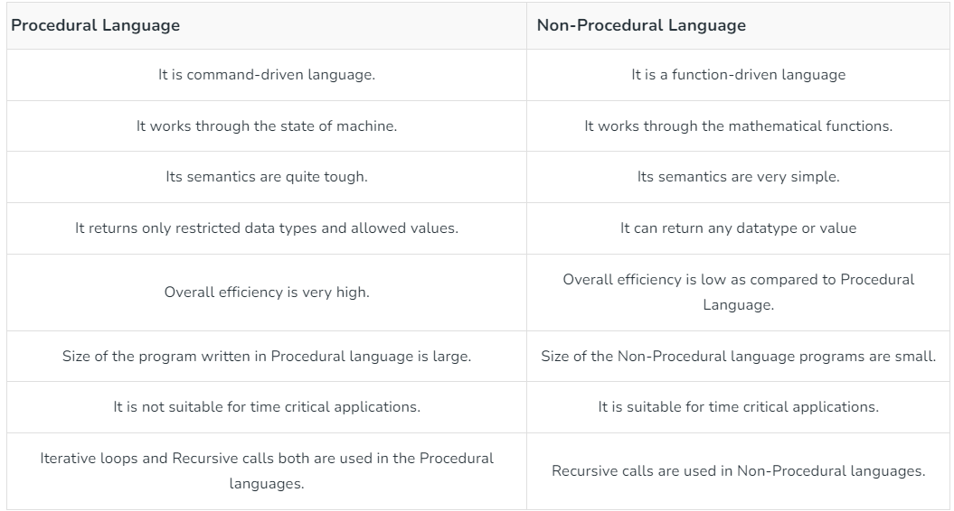
Procedural & Non-Procedural programming language

Slide 60
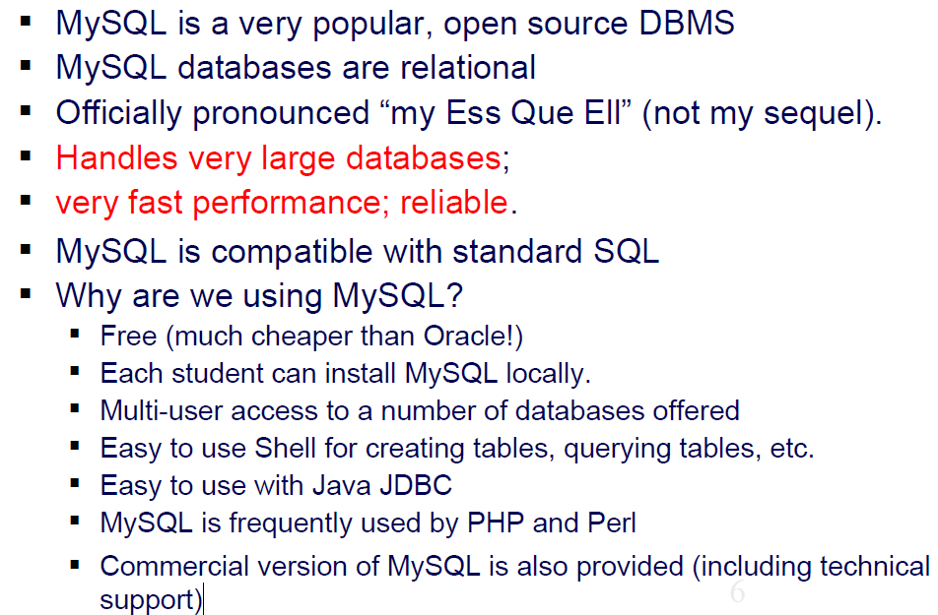
Introduction to MySQL

Slide 61
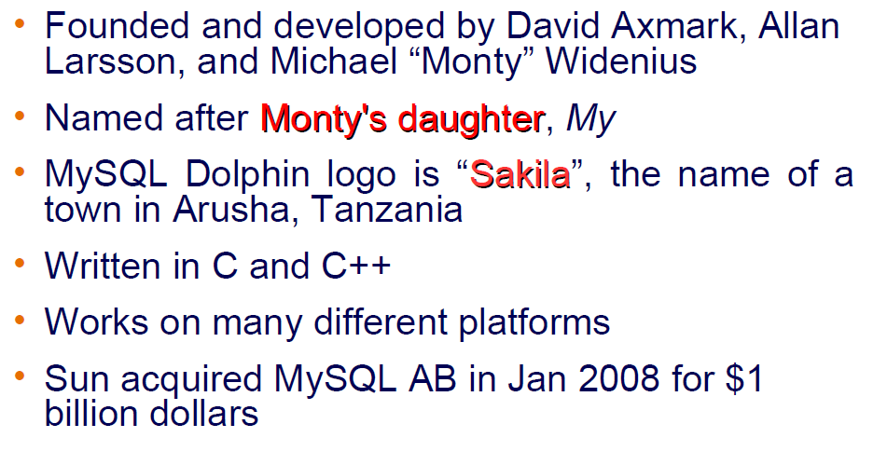
MySQL History

Slide 62
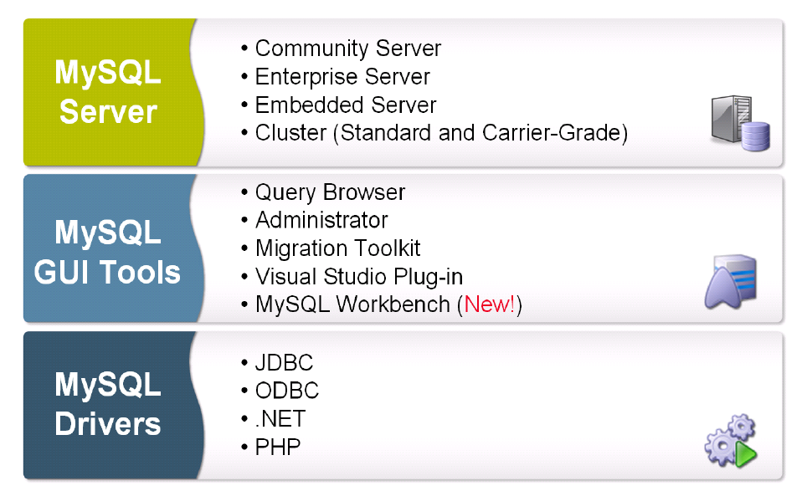
MySQL Products

Slide 63
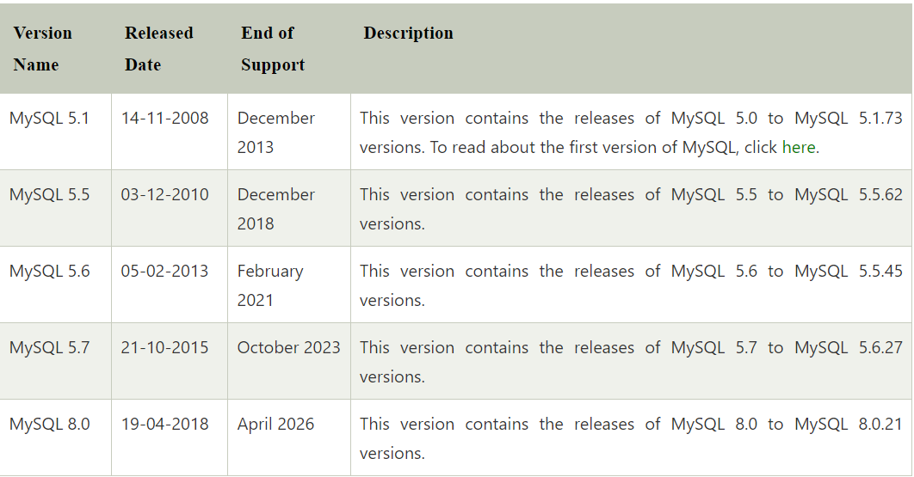
MySQL Versions

Slide 64
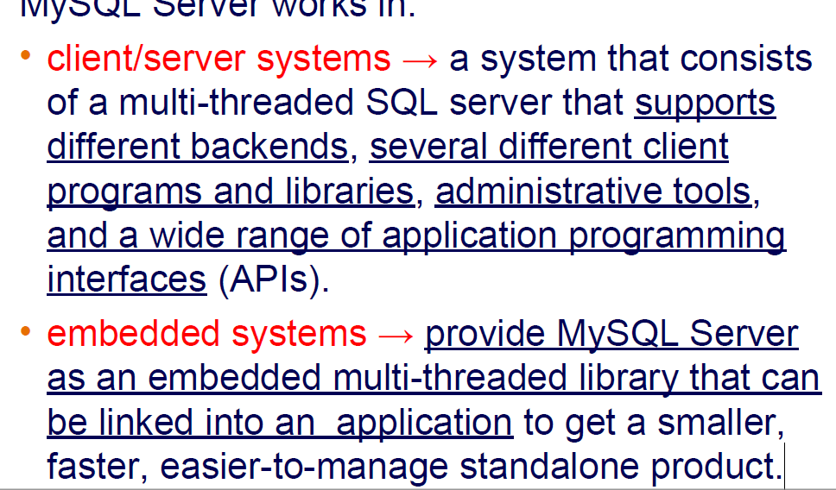
MySQL: characteristics

Slide 65
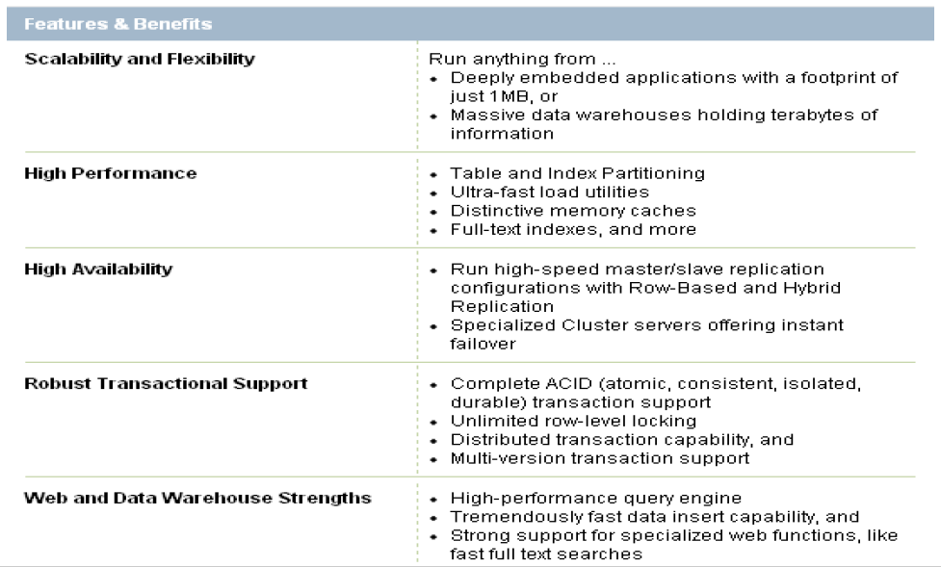
MySQL: Features and Benefits

Slide 66
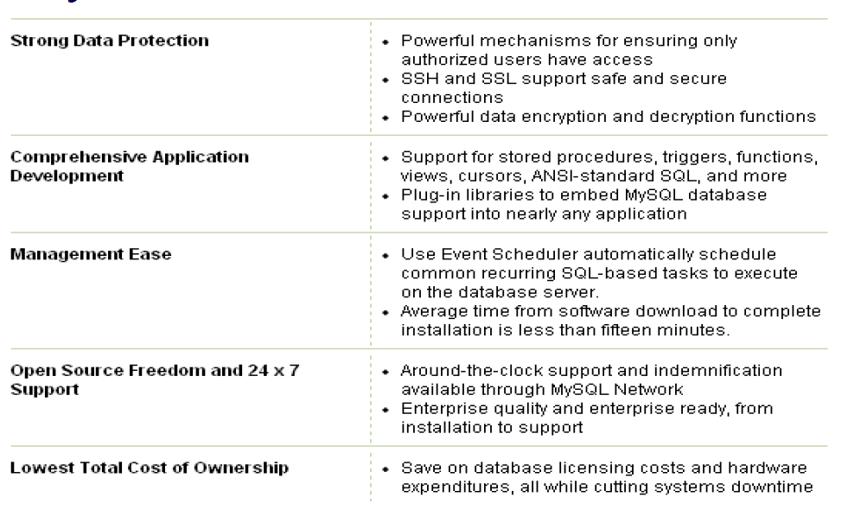
MySQL: Features and Benefits

Slide 67
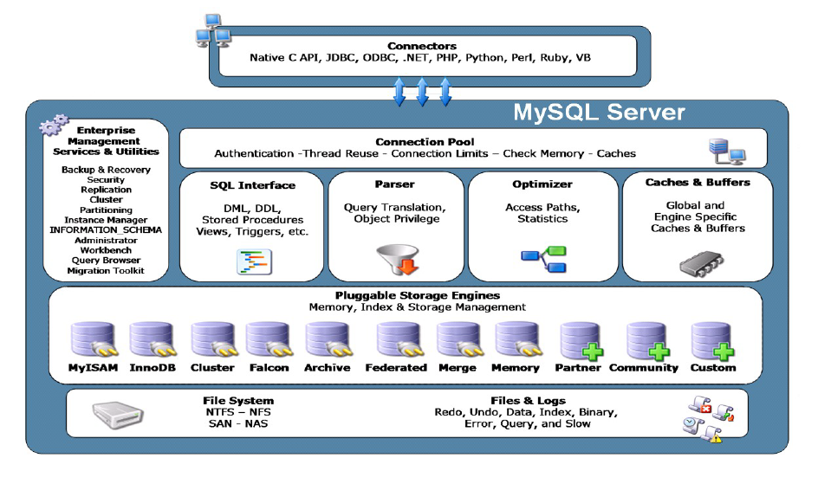
MySQL Architecture

Slide 68
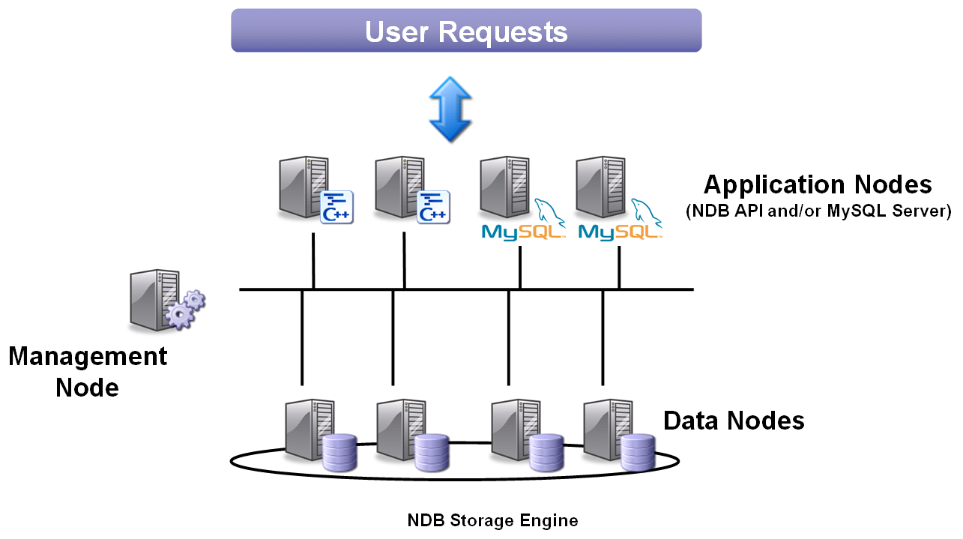
MySQL Clusters

Slide 69
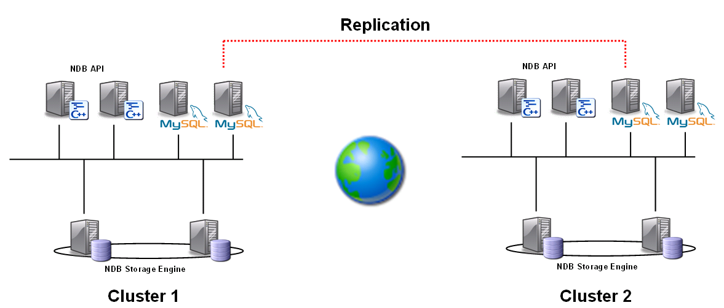
Geographic Redundancy
Asynchronous MySQL replication between clusters
Enables a higher degree of availability and continuity

Slide 70
Memcached
Developed by Danga Interactive to improve performance of LiveJournal
Distributed architecture layer that provides caching
Client/Server design
Servers are memcached daemons
Clients are implemented via language APIs like Java, PHP, C++, etc.

Slide 71
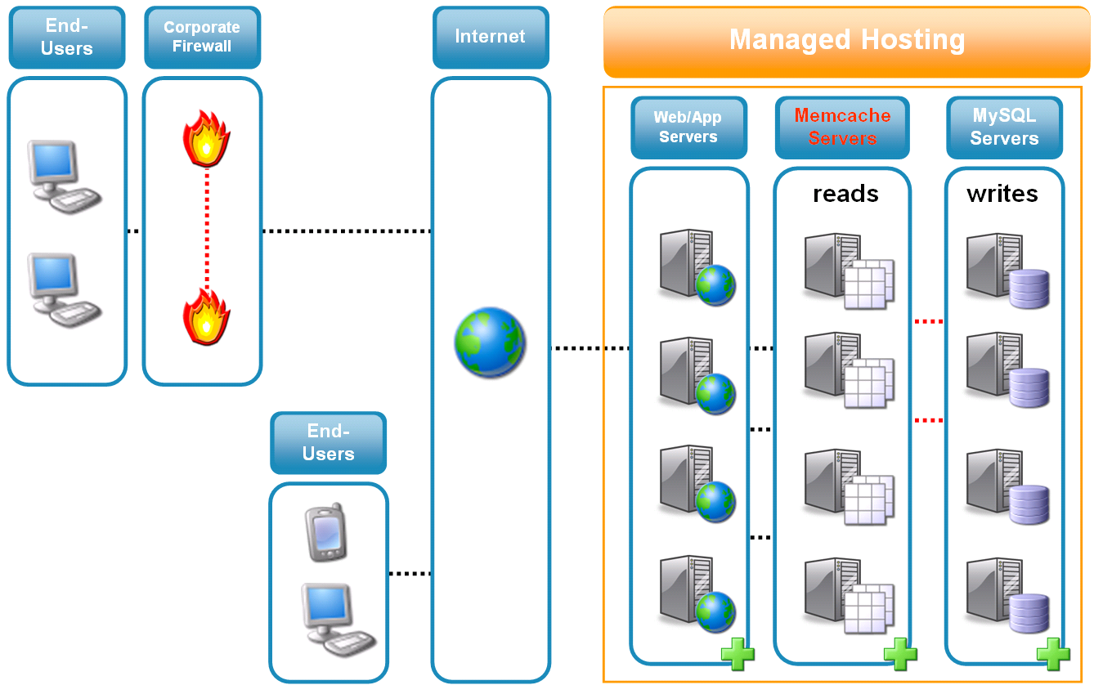
Memcached Supported with Enterprise Subscription

Slide 72
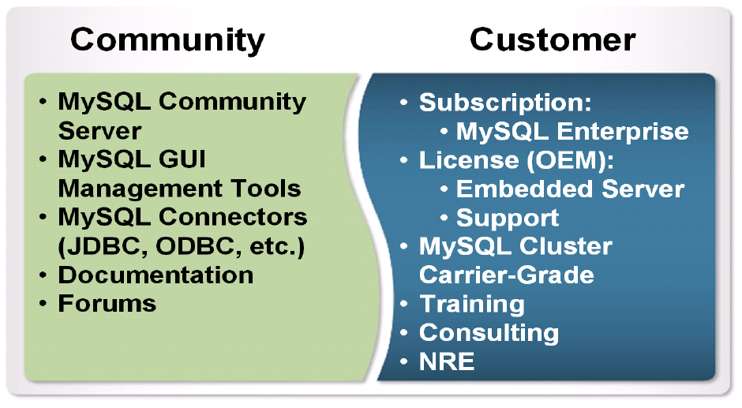
MySQL Community and Customers

Slide 73
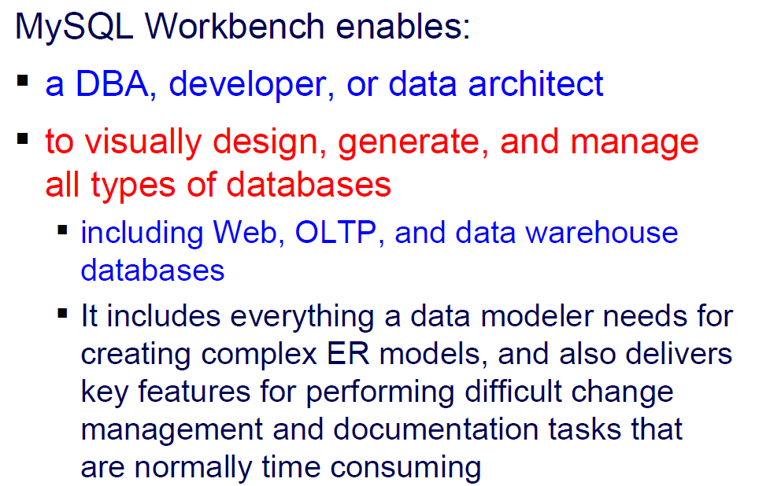
MySQL Workbench

Slide 74
How to install MySQL
Prerequisites
MySQL Setup Software
Microsoft .NET Framework 4.5.2
Microsoft Visual C++ Redistributable for Visual Studio 2019
RAM 4 GB (6 GB recommended)

Slide 75
Download MySQL
Step 1: Go to the official website of MySQL and download the community server edition software. Here, you will see the option to choose the Operating System, such as Windows.
Step 2: Next, there are two options available to download the setup.
Choose the version number for the MySQL community server, which you want.
If you have good internet connectivity, then choose the mysql-installer-web-community. Otherwise, choose the other one.

Slide 76
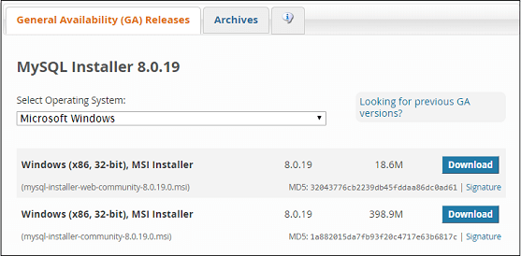
Download MySQL

Slide 77
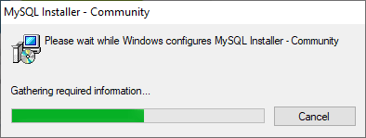
Download MySQL

Slide 78
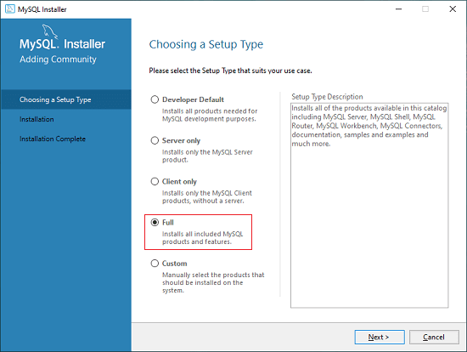
Download MySQL

Slide 79
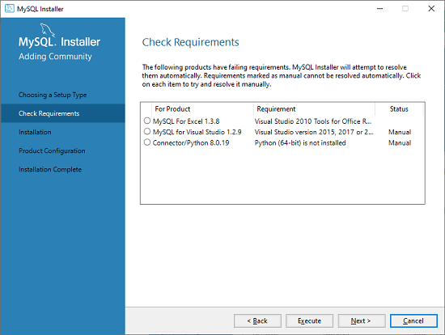
Download MySQL

Slide 80
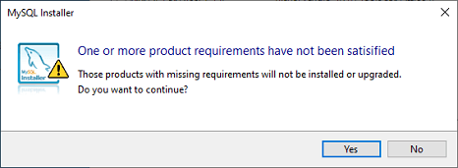
Download MySQL

Slide 81
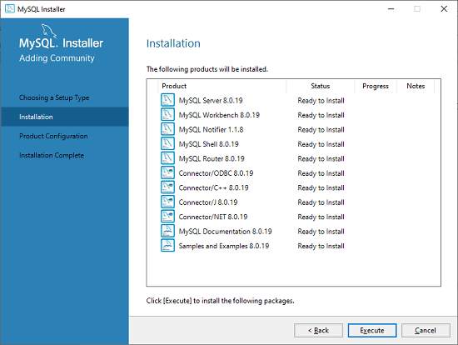
Download MySQL

Slide 82
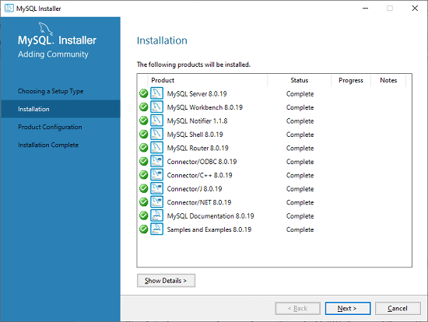
Download MySQL

Slide 83
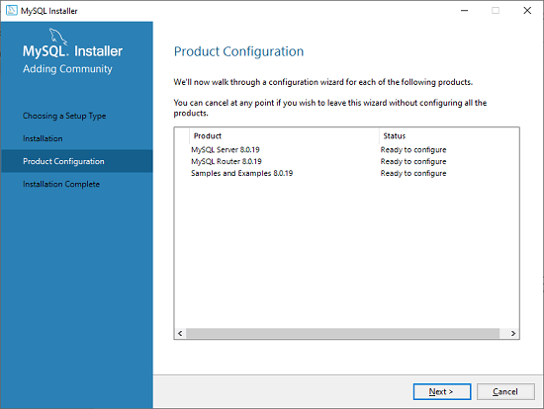
Download MySQL

Slide 84
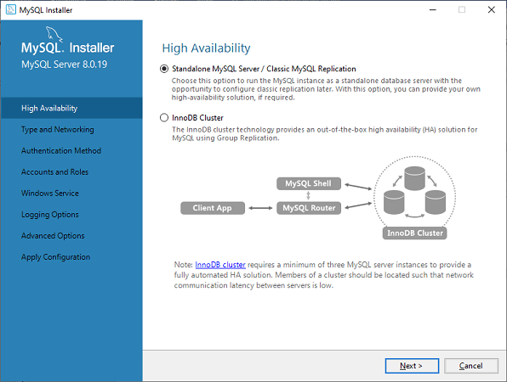
Download MySQL

Slide 85
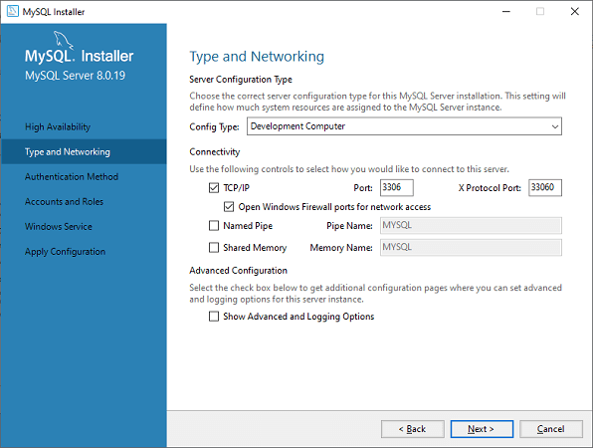
Download MySQL

Slide 86
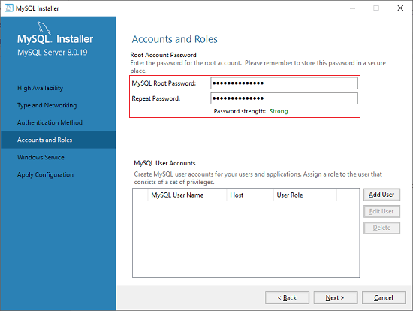
Download MySQL

Slide 87
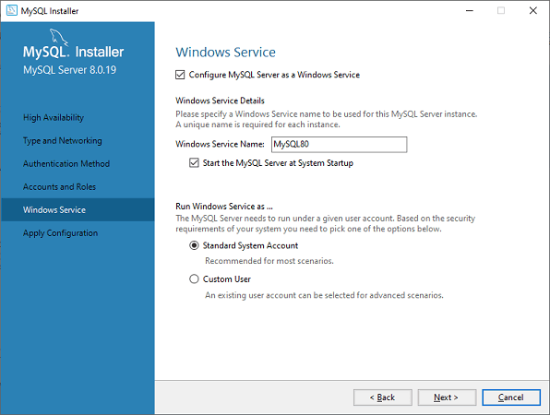
Download MySQL

Slide 88
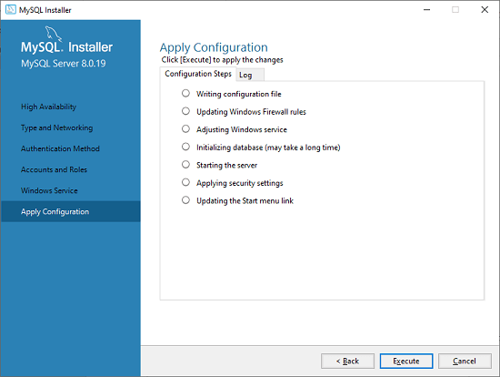
Download MySQL

Slide 89
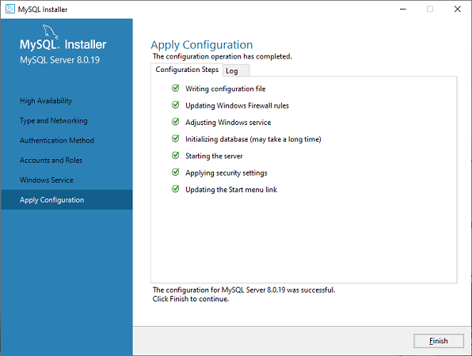
Download MySQL

Slide 90

Download MySQL

Slide 91
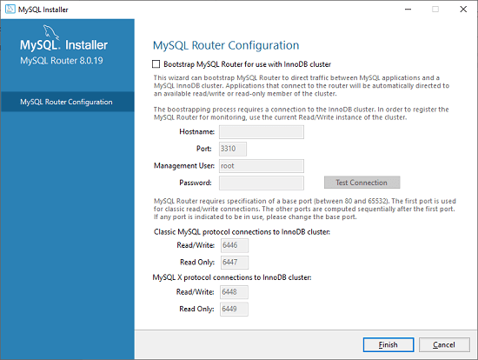
Download MySQL

Slide 92
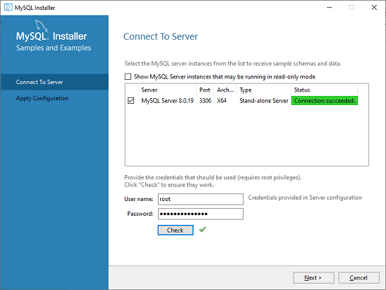
Download MySQL

Slide 93

Download MySQL

Slide 94
MySQL Table Types/Storage Engines
MySQL table types/storage engines are essential features that can be used effectively for maximizing the database's performance.
It handles create, read, and update operations for storing and managing the information in a database.

Slide 95
MySQL Table Types/Storage Engines
ISAM
MyISAM
MERGE
InnoDB
MEMORY (HEAP)
ARCHIVE
BDB
CSV
FEDERATED

Slide 96

MySQL Table Types/Storage Engines

Slide 97
MySQL Table Types/Storage Engines
ISAM Table
It is abbreviated as Indexed Sequential Access Method.
This table type/storage engine has been deprecated and removed from MySQL version 5.x.
MyISAM now replaces the functionalities of this table.
The size of an ISAM table is 4 GB, which requires expensive hardware. It is not portable.

Slide 98
MySQL Table Types/Storage Engines
MyISAM Table
It is an extension of the ISAM storage engine.
The MyISAM table types are optimized for compression and speed and can be easily portable between system to system.
Before version 5.5, if we do not specify the table type during table creation, it was the default storage engine.
From version 5.x, InnoDB is used as the default table type/storage engine.
The MyISAM table size is dependent on the OS and can be up to 256 TB.
It can be compressed into read-only tables that save spaces in memory.
MyISAM table type can store 64 keys per table and contains 1024 bytes maximum key length.
The MyISAM tables work very fast, but they are not transaction-safe.

Slide 99
MySQL Table Types/Storage Engines
MyISAM Table
MyISAM tables are not transactions-safe.
It has poor data integrity and crash recovery.
When we lock the entire table, in that case, MyISAM is slower than InnoDB.

Slide 100
MySQL Table Types/Storage Engines
InnoDB Table
The InnoDB tables in MySQL fully support transaction-safe storage engine with ACID-compliant.
It is the first table type that supports foreign keys.
The InnoDB tables also provide optimal performance. Its size can be up to 64TB.
InnoDB tables are also portable between systems to systems like MyISAM.
InnoDB tables can also be checked and repairs by MySQL whenever necessary.
InnoDB tables take more space on disk in comparison with MyISAM.

Slide 101
RDBMS and ER Model Refer PDF

Slide 102
Basic data types in SQL - Int, Float, Char
String Data Type
Data type | Description
CHAR(size) | A FIXED length string (can contain letters, numbers, and special characters). The size parameter specifies the column length in characters - can be from 0 to 255. Default is 1
VARCHAR(size) | A VARIABLE length string (can contain letters, numbers, and special characters). The size parameter specifies the maximum column length in characters - can be from 0 to 65535
BINARY(size) | Equal to CHAR(), but stores binary byte strings. The size parameter specifies the column length in bytes. Default is 1
VARBINARY(size) | Equal to VARCHAR(), but stores binary byte strings. The size parameter specifies the maximum column length in bytes.
TINYBLOB | For BLOBs (Binary Large OBjects). Max length: 255 bytes
TINYTEXT | Holds a string with a maximum length of 255 characters
TEXT(size) | Holds a string with a maximum length of 65,535 bytes
BLOB(size) | For BLOBs (Binary Large OBjects). Holds up to 65,535 bytes of data
MEDIUMTEXT | Holds a string with a maximum length of 16,777,215 characters
MEDIUMBLOB | For BLOBs (Binary Large OBjects). Holds up to 16,777,215 bytes of data
LONGTEXT | Holds a string with a maximum length of 4,294,967,295 characters
LONGBLOB | For BLOBs (Binary Large OBjects). Holds up to 4,294,967,295 bytes of data
ENUM(val1, val2, val3, ...) | A string object that can have only one value, chosen from a list of possible values. You can list up to 65535 values in an ENUM list. If a value is inserted that is not in the list, a blank value will be inserted. The values are sorted in the order you enter them
SET(val1, val2, val3, ...) | A string object that can have 0 or more values, chosen from a list of possible values. You can list up to 64 values in a SET list

Slide 103

Basic data types in SQL - Int, Float, Char
String Data Type

Slide 104
Basic data types in SQL - Int, Float, Char
Numeric Data Type
Data type | Description
BIT(size) | A bit-value type. The number of bits per value is specified in size. The size parameter can hold a value from 1 to 64. The default value for size is 1.
TINYINT(size) | A very small integer. Signed range is from -128 to 127. Unsigned range is from 0 to 255. The size parameter specifies the maximum display width (which is 255)
BOOL | Zero is considered as false, nonzero values are considered as true.
BOOLEAN | Equal to BOOL
SMALLINT(size) | A small integer. Signed range is from -32768 to 32767. Unsigned range is from 0 to 65535. The size parameter specifies the maximum display width (which is 255)
MEDIUMINT(size) | A medium integer. Signed range is from -8388608 to 8388607. Unsigned range is from 0 to 16777215. The size parameter specifies the maximum display width (which is 255)
INT(size) | A medium integer. Signed range is from -2147483648 to 2147483647. Unsigned range is from 0 to 4294967295. The size parameter specifies the maximum display width (which is 255)
INTEGER(size) | Equal to INT(size)
BIGINT(size) | A large integer. Signed range is from -9223372036854775808 to 9223372036854775807. Unsigned range is from 0 to 18446744073709551615. The size parameter specifies the maximum display width (which is 255)
FLOAT(size, d) | A floating point number. The total number of digits is specified in size. The number of digits after the decimal point is specified in the d parameter. This syntax is deprecated in MySQL 8.0.17, and it will be removed in future MySQL versions
FLOAT(p) | A floating point number. MySQL uses the p value to determine whether to use FLOAT or DOUBLE for the resulting data type. If p is from 0 to 24, the data type becomes FLOAT(). If p is from 25 to 53, the data type becomes DOUBLE()
DOUBLE(size, d) | A normal-size floating point number. The total number of digits is specified in size. The number of digits after the decimal point is specified in the d parameter
DOUBLE PRECISION(size, d)
DECIMAL(size, d) | An exact fixed-point number. The total number of digits is specified in size. The number of digits after the decimal point is specified in the d parameter. The maximum number for size is 65. The maximum number for d is 30. The default value for size is 10. The default value for d is 0.
DEC(size, d) | Equal to DECIMAL(size,d)

Slide 105
Basic data types in SQL - Int, Float, Char
Date and Time Data Type
Data type | Description
DATE | A date. Format: YYYY-MM-DD. The supported range is from '1000-01-01' to '9999-12-31'
DATETIME(fsp) | A date and time combination. Format: YYYY-MM-DD hh:mm:ss. The supported range is from '1000-01-01 00:00:00' to '9999-12-31 23:59:59'. Adding DEFAULT and ON UPDATE in the column definition to get automatic initialization and updating to the current date and time
TIMESTAMP(fsp) | A timestamp. TIMESTAMP values are stored as the number of seconds since the Unix epoch ('1970-01-01 00:00:00' UTC). Format: YYYY-MM-DD hh:mm:ss. The supported range is from '1970-01-01 00:00:01' UTC to '2038-01-09 03:14:07' UTC. Automatic initialization and updating to the current date and time can be specified using DEFAULT CURRENT_TIMESTAMP and ON UPDATE CURRENT_TIMESTAMP in the column definition
TIME(fsp) | A time. Format: hh:mm:ss. The supported range is from '-838:59:59' to '838:59:59'
YEAR | A year in four-digit format. Values allowed in four-digit format: 1901 to 2155, and 0000. MySQL 8.0 does not support year in two-digit format.

Slide 106

Database
A character set is a set of characters while a collation is the rules for comparing and sorting a particular character set.

Slide 107
Database
CREATE DATABASE mydatabase;
CREATE DATABASE IF NOT EXISTS mydatabase;
CREATE DATABASE mydatabase CHARACTER SET utf8mb4 COLLATE utf8mb4_unicode_ci;
CREATE DATABASE db_name CHARACTER SET latin1 COLLATE latin1_swedish_ci;
Determine default charset and collate
USE db_name;
SELECT @@character_set_database, @@collation_database;

Slide 108
Database
SELECT DEFAULT_CHARACTER_SET_NAME, DEFAULT_COLLATION_NAME
FROM INFORMATION_SCHEMA.SCHEMATA WHERE SCHEMA_NAME = 'db_name';

Slide 109

CRUD operations on Database(Create, Drop)

Slide 110

CRUD operations on Database(Create, Drop)

Slide 111

CRUD operations on Database(Create, Drop)

Slide 112



CRUD operations on Database(Create, Drop)
Remove space between words

Slide 113

CRUD operations on Database(Create, Drop)

Slide 114

CRUD operations on Database(Create, Drop)

Slide 115

CRUD operations on Database(Create, Drop)

Slide 116

CRUD operations on Database(Create, Drop)

Slide 117

CRUD operations on Database(Create, Drop)

Slide 118

CRUD operations on Database(Create, Drop)

Slide 119

CRUD operations on Database(Create, Drop)
The DECIMAL type is commonly used for storing currency amounts, percentages, and other data that requires high-precision calculations.
Due to issues with floating-point precision, it is not recommended to use the FLOAT or DOUBLE data types in these cases.

Slide 120

CRUD operations on Database(Create, Drop)

Slide 121

CRUD operations on Database(Create, Drop)

Slide 122

CRUD operations on Database(Create, Drop)

Slide 123



CRUD operations on Database(Create, Drop)

Slide 124


CRUD operations on Database(Create, Drop)
Rename Column
Drop Column

Slide 125

CRUD operations on Database(Create, Drop)
MySQL ALTER TABLE – Rename table

Slide 126

CRUD operations on Database(Create, Drop)

Slide 127

CRUD operations on Database(Create, Drop)

Slide 128

Constraints

Slide 129
CRUD operations on Database(Create, Drop)
create table Customer(Customer_Id BIGINT NOT NULL AUTO_INCREMENT, Age SMALLINT, Email Varchar(150), Name Varchar(100), Category Varchar(30),
Constraint Customer_Id_PK Primary Key(Customer_Id),
Constraint Email_UK Unique(Email),
INDEX (Customer_Id,Name)
);

Slide 130
Bulk Insert
SHOW VARIABLES LIKE "secure_file_priv";
Go to C:\ProgramData\MySQL\MySQL Server 8.0\my.ini
Search for secure-file-priv and make it empty
[mysqld]
secure-file-priv = “”
Restart mysql

Slide 131
Bulk Insert
LOAD DATA INFILE 'data.txt' INTO TABLE tbl_name
FIELDS TERMINATED BY ',' ENCLOSED BY '"'
LINES TERMINATED BY '\r\n'
IGNORE 1 LINES;

Slide 132
Bulk Insert (alternative)
mysql --local-infile=1 -u root -p
SET GLOBAL local_infile=1;

Slide 133
Bulk Insert
LOAD DATA LOCAL INFILE 'F:/Local disk/MySql/presentations/customer.csv' INTO TABLE bankingdb.customer
FIELDS TERMINATED BY ',' ENCLOSED BY '"'
LINES TERMINATED BY '\r\n'
IGNORE 1 LINES;

Slide 134

SQL Built-In Function

Slide 135

SQL Built-In Function

Slide 136

SQL Built-In Function

Slide 137

SQL Built-In Function

Slide 138

SQL Built-In Function

Slide 139

SQL Built-In Function

Slide 140

SQL Built-In Function

Slide 141

SQL Built-In Function

Slide 142

SQL Built-In Function

Slide 143

SQL Built-In Function

Slide 144

SQL Built-In Function

Slide 145

SQL Built-In Function

Slide 146

SQL Built-In Function

Slide 147

SQL Built-In Function

Slide 148

SQL Built-In Function

Slide 149

SQL Built-In Function

Slide 150

SQL Built-In Function

Slide 151

SQL Built-In Function

Slide 152

SQL Built-In Function

Slide 153

SQL Built-In Function

Slide 154

SQL Built-In Function

Slide 155

SQL Built-In Function

Slide 156

Load Queries from .SQL file
mysql -u root -p <"F:/Local disk/MySql/presentations/mysqlsampledatabase.sql"

Slide 157

Order by

Slide 158

Second Highest Using Subquery
select max(buyprice) from products where buyprice < (select max(buyprice) from products);

Slide 159
Subquery
select * from customers where creditlimit in (select creditLimit from customers where creditlimit<65000);

Slide 160
Like
select customerName from customers where customerName like 'R%';

Slide 161

Alias
select customerName as "Customer Name" from customers where customerName like 'R%';

Slide 162

Inner Join

Slide 163
Inner Join
select c.customerName,c.city,o.shippedDate from customers c inner join orders o on c.customerNumber=o.customerNumber
select c.customerName,c.city,o.shippedDate from customers c inner join orders o where c.customerNumber=o.customerNumber and o.shippedDate is NOT NULL;

Slide 164
Inner Join
select concat(e.firstName," ",e.lastName) as "Employee Name", concat(o.addressLine1," ",o.addressLine2," ",city," ",state," ",country," ",postalcode) as "Office Address" from employees e inner join offices o where e.officecode=o.officecode and o.addressLine1 is not null and o.addressLine2 is not null and city is not null and state is not null;

Slide 165

Right Join

Slide 166
Right Join
select c.customerName,c.city,o.shippedDate from customers c right join orders o using(customerNumber);

Slide 167





Right Join With Condition

Slide 168
Right Join with Condition
select c.customerName,c.city,o.shippedDate from customers c right join orders o using(customerNumber) where o.shippedDate is NOT NULL;

Slide 169

Left Join

Slide 170
Left Join
select c.customerName,c.city,o.shippedDate from customers c left join orders o using(customerNumber);

Slide 171
MySQL CROSS JOIN clause
select c.customerName,c.city,o.shippedDate from customers c cross join orders o;

Slide 172
MySQL Self JOIN clause
select concat(e.firstName,e.lastName) as "Employee Name", concat(m.firstName,m.lastName) as "Manager Name" from employees e LEFT JOIN employees m on m.reportsTo=e.employeeNumber;

Slide 173

MySQL Self JOIN clause

Slide 174
Indexing
In MySQL, an index is a data structure used to quickly find rows.
Indexes are also called keys and those keys are critical for good performance – as the data grows larger, the need of using indexes properly might become more and more important.
Using indexes is one of the most powerful ways to improve query performance – if indexes are used properly, query performance might increase by tens or even hundreds of times.

Slide 175
Indexing
Indexes allow to quickly find rows matching a WHERE clause;
Indexes might help queries avoid searching through certain rows thus reducing the amount of data the server needs to examine – if there is a choice between multiple indexes, MySQL usually uses the most selective index, that is such an index that finds the smallest number of rows;
Indexes might be used to retrieve rows from other tables in JOIN operations;
Indexes might be used to find the minimum or the maximum value of a specific column that uses an index;
Indexes might be used to sort or group a table if the operations are performed on a leftmost prefix of an index – similarly, a leftmost prefix of a multiple-column index might also be used by the query optimizer to look up rows;
Indexes might also be used to save disk I/O – when a covering index is in use, a query can return values straight from the index structure saving disk I/O.

Slide 176
Multiple Types of Indexing
INDEX is a type of index where values do not need to be unique. This type of index accepts NULL values;
UNIQUE INDEX is frequently used to remove duplicate rows from a table – this type of index allows developers to enforce the uniqueness of row values;
FULLTEXT INDEX is an index that is applied on fields that utilize full text search capabilities. This type of index finds keywords in the text instead of directly comparing values to the values in the index;
DESCENDING INDEX is an index that stores rows in a descending order – the query optimizer will choose this type of an index when a descending order is requested by the query. This index type was introduced in MySQL 8.0;
PRIMARY KEY is also an index. In a nutshell, the PRIMARY KEY is a column or a set of columns that identifies each row in a table – frequently used together with fields having an AUTO_INCREMENT attribute. This type of index does not accept NULL values and once set, the values in the PRIMARY KEY cannot be changed.

Slide 177
Indexing
EXPLAIN SELECT * FROM employees WHERE salary = 100000;

Slide 178
Indexing
CREATE INDEX salary ON employees(salary);
CREATE INDEX names ON employees(last_name, first_name);
CREATE UNIQUE INDEX idx_name_phone ON contacts(first_name,last_name,phone);
create an index with the prefix length 20 for the productName column:
CREATE INDEX idx_productname ON products(productName(20));
SHOW INDEXES FROM employees;
DROP INDEX device_serial ON employees;

Slide 179
Indexing
ALTER Table TableName ADD PRIMARY KEY (ColumName);
ALTER Table TableName ADD UNIQUE Index_Name (ColumName);
ALTER Table TableName ADD INDEX Index_Name (ColumName);
ALTER Table TableName ADD FULLTEXT Index_Name (ColumName)

Slide 180
Stored Procedure and Function

Slide 181
Normalization
DBMS Normalization is a systematic approach to decompose (break down) tables to eliminate data redundancy(repetition) and undesirable characteristics like Insertion anomaly in DBMS, Update anomaly in DBMS, and Delete anomaly in DBMS.

Slide 182
Why we need Normalization in DBMS?
Eliminating redundant(useless) data, therefore handling data integrity, because if data is repeated it increases the chances of inconsistent data.
Normalization helps in keeping data consistent by storing the data in one table and referencing it everywhere else.
Storage optimization although that is not an issue these days because Database storage is cheap.
Breaking down large tables into smaller tables with relationships, so it makes the database structure more scalable and adaptable.
Ensuring data dependencies make sense i.e. data is logically stored.

Slide 183

Why we need Normalization in DBMS?

Slide 184
Why we need Normalization in DBMS?
Insertion Anomaly in DBMS
Suppose for a new admission, until and unless a student opts for a branch, data of the student cannot be inserted, or else we will have to set the branch information as NULL.
Also, if we must insert data for 100 students of the same branch, then the branch information will be repeated for all those 100 students.
These scenarios are nothing but Insertion anomalies.
If you must repeat the same data in every row of data, it's better to keep the data separately and reference that data in each row.
So, in the above table, we can keep the branch information separately, and just use the branch_id in the student table, where branch_id can be used to get the branch information.

Slide 185
Why we need Normalization in DBMS?
Updating Anomaly in DBMS
What if Mr. X leaves the college? or Mr. X is no longer the HOD of the computer science department?
In that case, all the student records will have to be updated, and if by mistake we miss any record, it will lead to data inconsistency.
This is an Updating anomaly because you need to update all the records in your table just because one piece of information got changed.

Slide 186
Why we need Normalization in DBMS?
Deletion Anomaly in DBMS
In our Student table, two different pieces of information are kept together, the Student information and the Branch information.
So, if only a single student is enrolled in a branch, and that student leaves the college, or for some reason, the entry for the student is deleted, we will lose the branch information too.
So never in DBMS, we should keep two different entities together, which in the above example is Student and branch,

Slide 187

Primary Key and Non-key attributes

Slide 188
Types of DBMS Normal forms
Normalization rules are divided into the following normal forms:
First Normal Form
Second Normal Form
Third Normal Form
BCNF
Fourth Normal Form
Fifth Normal Form

Slide 189
First Normal Form (1NF)
For a table to be in the First Normal Form, it should follow the following 4 rules:
It should only have single(atomic) valued attributes/columns.
Values stored in a column should be of the same domain.
All the columns in a table should have unique names.
And the order in which data is stored should not matter.

Slide 190

First Normal Form (1NF)
If we have an Employee table in which we store the employee information along with the employee skillset, the table will look like this:

Slide 191
First Normal Form (1NF)
emp_skills column holds multiple comma-separated values, while as per the First Normal form, each column should have a single value.
Remove the emp_skills column from the Employee table and keep it in some other table.
Or add multiple rows for the employee and each row is linked with one skil

Slide 192

Create Separate tables for Employee and Employee Skills

Slide 193

Create Separate tables for Employee and Employee Skills

Slide 194

Add Multiple rows for Multiple skills

Slide 195
Second Normal Form (2NF)
For a table to be in the Second Normal Form,
It should be in the First Normal form.
And, it should not have Partial Dependency.

Slide 196
What is Partial Dependency?
When a table has a primary key that is made up of two or more columns, then all the columns(not included in the primary key) in that table should depend on the entire primary key and not on a part of it.
If any column(which is not in the primary key) depends on a part of the primary key, then we say we have Partial dependency in the table.

Slide 197

What is Partial Dependency?

Slide 198

What is Partial Dependency?

Slide 199
What is Partial Dependency?
Now in the above table, the primary key is student_id + subject_id, because both these information are required to select any row of data.
But in the Score table, we have a column teacher_name, which depends on the subject information or just the subject_id, so we should not keep that information in the Score table.
The column teacher_name should be in the Subjects table. And then the entire system will be Normalized as per the Second Normal Form.

Slide 200

What is Partial Dependency?

Slide 201
Third Normal Form (3NF)
A table is said to be in the Third Normal Form when,
It satisfies the First Normal Form and the Second Normal form.
And, it doesn't have Transitive Dependency.

Slide 202
What is Transitive Dependency?
In a table we have some column that acts as the primary key and other columns depends on this column.
But what if a column that is not the primary key depends on another column that is also not a primary key or part of it?
Then we have Transitive dependency in our table.

Slide 203

What is Transitive Dependency?

Slide 204
What is Transitive Dependency?
In the table above, the column exam_type depends on both student_id and subject_id, because,
a student can be in the CSE branch or the Mechanical branch and based on that they may have different exam types for different subjects.
The CSE students may have both Practical and Theory for Compiler Design, whereas Mechanical branch students may only have Theory exams for Compiler Design.
But the column total_marks just depends on the exam_type column.
And the exam_type column is not a part of the primary key.
Because the primary key is student_id + subject_id, hence we have a Transitive dependency here.

Slide 205

What is Transitive Dependency?

Slide 206
BCNF
Boyce and Codd Normal Form is a higher version of the Third Normal Form.
This form deals with a certain type of anomaly that is not handled by 3NF.
A 3NF table that does not have multiple overlapping candidate keys is said to be in BCNF.

Slide 207
BCNF
For a table to be in BCNF, the following conditions must be satisfied:
R must be in the 3rd Normal Form
and, for each functional dependency ( X → Y ), X should be a Super Key.

Slide 208

BCNF

Slide 209
BCNF
One student can enrol for multiple subjects. For example, student with student_id 101, has opted for subjects - Java & C++
For each subject, a professor is assigned to the student.
And, there can be multiple professors teaching one subject like we have for Java.

Slide 210
BCNF
In the table above, student_id, subject form primary key, which means subject column is a prime attribute.
But there is one more dependency, professor → subject.
And while subject is a prime attribute, professor is a non-prime attribute, which is not allowed by BCNF.

Slide 211

How to satisfy BCNF?

Slide 212
Fourth Normal Form (4NF)
Fourth Normal Form comes into picture when Multi-valued Dependency occur in any relation.

Slide 213
Rules for 4th Normal Form
For a table to satisfy the Fourth Normal Form, it should satisfy the following two conditions:
It should be in the Boyce-Codd Normal Form.
And the table should not have any Multi-valued Dependency.

Slide 214
What is Multi-valued Dependency?
A table is said to have multi-valued dependency, if the following conditions are true,
For a dependency A → B, if for a single value of A, multiple value of B exists, then the table may have multi-valued dependency.
Also, a table should have at-least 3 columns for it to have a multi-valued dependency.
And, for a relation R(A,B,C), if there is a multi-valued dependency between, A and B, then B and C should be independent of each other.

Slide 215

What is Multi-valued Dependency?

Slide 216

What is Multi-valued Dependency?

Slide 217

How to satisfy 4th Normal Form?

Slide 218

How to satisfy 4th Normal Form?

Slide 219
Fifth Normal Form (5NF)
The fifth normal form is also called the PJNF - Project-Join Normal Form
It is the most advanced level of Database Normalization.
Using Fifth Normal Form you can fix Join dependency and reduce data redundancy.
It also helps in fixing Update anomalies in DBMS design.

Slide 220
Questions

Slide 221
Module Summary
MySQL Basic to Intermediate
MongoDB Foundation and Cloud

